Slide 1
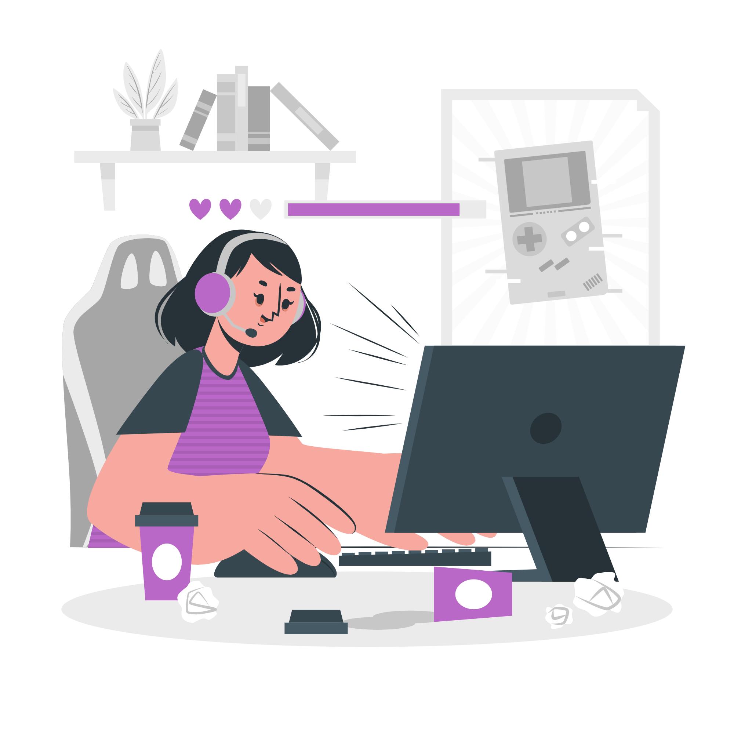
Post-secondary CS Education
Trisha Kulkarni, Juliette Woodrow, Daniel Rebelsky, Angela Chen
Notes:
Team intro: names
Our theme: post-secondary CS education

Slide 2




Our Interviewees
Year
From social circles
Interviewed on Zoom
From a range of school years
Have a range of CS experience
From different types of schools
Cathy
Sery
Carolyne
José
CS experience
Notes:
Our interviewees cover a range of school year and CS experience. Jose and Cathy are our extreme users as they both had little CS backgrounds, and Cathy is an international grad student. Sery and Carolyne represent the our average users as they are undergrad CS major students.

Slide 3
Can you walk me through a lecture experience?
What’s your most memorable CS learning experience?
What tools did you use outside of the classroom?
How do you approach an assignment? What’s the flow?
How did you feel when sitting in that classroom?
How do you describe your learning style?
?
What was the most negative experience in that class?
Tell me about your favorite instructor.
At which points did you feel the most stressed?
Why was that experience such a huge surprise?
What’s the biggest difference between CS and your major?
What made that assignment so special?
What pushed you away from CS, why?

Slide 4

“I rarely reach out for help when doing my assignments, but it’s always good to know there’s help available so that I feel safe trying to solve problems on my own.”
— Cathy MS&E Grad Student at Stanford

Slide 5

“I'm kind of independent in computer science classes because I don't want to hear that, ‘Oh, you don't know how to do this? Well, we learned this in freshman year.’”
— Carolyne Junior CS Major at Yale

Slide 6

“When starting out, being able to form connections and feeling a sense of belonging is crucial in staying involved.”
— Sery Junior CS Major at OSU

Slide 7

“The first stereotype that I think of is like someone just at their computer for 12 hours per day in a dark place—in a dark basement, typing away at code for 12 hours a day… that's the first thing that comes to mind.”
— José Math/Econ Major at a SLAC

Slide 8
Analysis
From our interviews, we learned...

Slide 9
Say
“I felt the need to protect my work from other students”
“It’s not the culture to ask classmates for help on the homework”
“It’s hard to contribute when you look around and no one is like you”
“CS seems like a solitary discipline”
“I was worried I was behind before I even started”
“Discussion sections were the most helpful part of the course”
“People behind me in lecture complained about grades that were high A’s which made me feel like I didn’t belong in this class”
“I work independently to protect my confidence and sense of belonging”
“My first CS class was collaborative which drew me in to the field”
“Knowing that I have a safety net makes me more empowered to work on solving problems on my own”
Notes:
“CS seems like a solitary discipline” “I work independently to protect my confidence and sense of belonging” “Knowing that I have a safety net makes me more empowered to work on solving problems on my own”

Slide 10
Think
CS is a powerful tool
The typical CS student likes to work alone
CS students must be self reliant
Other people know so much more than me
Slope does NOT make up for y intercept
None of my peers want to help me
It is more rewarding to succeed when you work independently
Collaboration is so helpful
Need to start CS early to really succeed
Others are ahead of me because they are working on side projects
Notes:
Other people know so much more than me None of my peers want to help me It is more rewarding to succeed when you work independently

Slide 11
Do
Take CS classes even if they are intimidated
Recognize the application of CS
Work on homework mostly independently
Only collaborate with non-intimidating peers
Rely on staff support rather than classmates
Utilize in person resources rather than online
Pretend you are doing really well even when struggling
Create a self-imposed limitation on possible connections in the course
Falsely put other students on pedestals
Teach other students to demonstrate mastery and feel a sense of belonging
Notes:
Work on homework mostly independently Pretend you are doing really well even when struggling Falsely put other students on pedestals

Slide 12

Feel
Isolated
Inexperienced
Like an imposter
Self conscious
Intimidated
Competitive
Underrepresented
Challenged
A sense of progress
Accomplishment
Notes:
Isolated Like an imposter Intimidated Underrepresented

Slide 13




What’s Interesting/Surprising
CS is not a collaborative culture
Collaboration can be helpful
Supported by professors
Intimidated or isolated by peers
Feeling behind is demoralizing
It can also be motivating
CS intro courses are for beginners
Diverse experience levels

Slide 14
Insight
Need
Students feel that their classmates judge them based on their CS abilities more than their peers actually do
A judgement free space to collaborate
Feelings of intimidation come from unstructured parts of the course (working on homework and office hours)
Exposure to other students’ challenges

Slide 15
Insight
Need
Students feel empowered when they solve problems on their own, but feel discouraged when they need support
More opportunities to solidify understanding rather than fixing hw problems
Students have a big impact on the morale of their peers (more than they intend to)
More awareness of how one’s actions impact the morale of their peers

Slide 16
Insight
Need
Students feel a stronger sense of belonging when they see people who are like them
Reassurance that you’re not the first or only person with this identity
Collaboration puts stress on both parties if they aren’t at the same point in their work
An environment or opportunity that makes collaboration mutually beneficial

Slide 17


Insight
Need
Teaching a concept empowers students and fosters and sense of belonging
Opportunities for students to teach their peers or near-peers

Slide 18

Summary
Our problem space is post-secondary CS education
We interviewed four people with different CS experiences
We discovered what students like or struggle with and some common needs
We will continue exploring the problem space while interviewing broader groups of users/non-users

Slide 19


Further Questions
If peers make someone feel intimidated and professors make them feel welcome, which one of these factors wins out?
Is it more important for students to feel ownership or camaraderie when completing an assignment?
How to eliminate judgement / incentive to compete in collaboration?
How to diversify exposure to other students and leaders in the field?
Can we influence how people talk about the course outside of class?

Slide 20
What questions do you have?

